Slide 1
Machine Learning

Slide 2
Outline
Last Class
Machine Learning and Pattern Recognition
Supervised Learning, Unsupervised Learning, Reinforcement Learning
Decision process
Feature selection
Pattern recognition process
Today
ML Life cycle
Performance Measure Parameters
Classification Accuracy (mostly used)
Confusion Matrix
Area under Curve
Mean Absolute Error
Mean Squared Error
Common ML Problems

Slide 3
Machine learning Life cycle
A cyclic process to build an efficient machine learning project.
The main purpose of the life cycle is to find a solution to the problem or project.
Machine learning life cycle involves seven major steps, which are given below:
Gathering Data
Data preparation
Data Wrangling (Data cleansing)
Analyze Data
Train the model
Test the model
Deployment

Slide 4
1. Gathering Data
The first and most important step of the ML life cycle.
The goal is to identify and obtain all data-related problems.
The quantity and quality of the collected data will determine the efficiency of the output.
The more will be the data, the more accurate will be the prediction.
This step includes the below tasks:
Identify various data sources such as files, database, internet etc.
Collect data
Integrate the data obtained from different sources
By the end of this step, a dataset is gathered to be used in further steps.

Slide 5
2. Data preparation
Data preparation is a step where we put our data into a suitable place and prepare it to use in our machine learning training.
Put all data together, and then randomize the ordering of data.
This step can be further divided into two processes:
Data exploration:
Understand the nature of data
Understand the characteristics, format, and quality of data.
Data pre-processing:
Manipulating the data so that it can run through the appropriate machine learning technique with no problems.
converting categorical columns into numerical columns
Notes:
https://www.quora.com/What-is-the-difference-between-data-preprocessing-and-data-wrangling

Slide 6
3. Data Wrangling
The process of cleaning and converting raw data into a useable format, to make it more suitable for analysis in the next step
May involve dealing with following issues:
Missing Values
Duplicate data
Invalid data
Noise
So, Data can be cleaned by either removing rows with missing/ duplicate values or imputing the missing values
Typically done by a data scientist or business analyst to change views on a dataset and for features engineering.

Slide 7
4. Data Analysis
The cleaned and prepared data is passed on to the analysis step that involves:
Determination of the type of the problem
Selection of analytical techniques such as Classification, Regression, Cluster analysis, Association
Building models, e.g. setting the parameters

Slide 8
Model Training, Testing and Deployment
Train Model
Feed dataset to ML algorithms so that it can understand the various patterns, rules, and, features.
Test Model
Test the trained model using test unseen dataset
Goal is to check the accuracy of the model
Deployment
Deploy the model in the real-world system, if it is producing an accurate result as per our requirement with acceptable speed
similar to making the final report for a project.

Slide 9
Evaluating matrices of model
The performance of a ML model is evaluated using some or all of these evaluation metrics
Classification Accuracy (mostly used)
Confusion Matrix
Area under Curve
F1 Score
Mean Absolute Error
Mean Squared Error

Slide 10
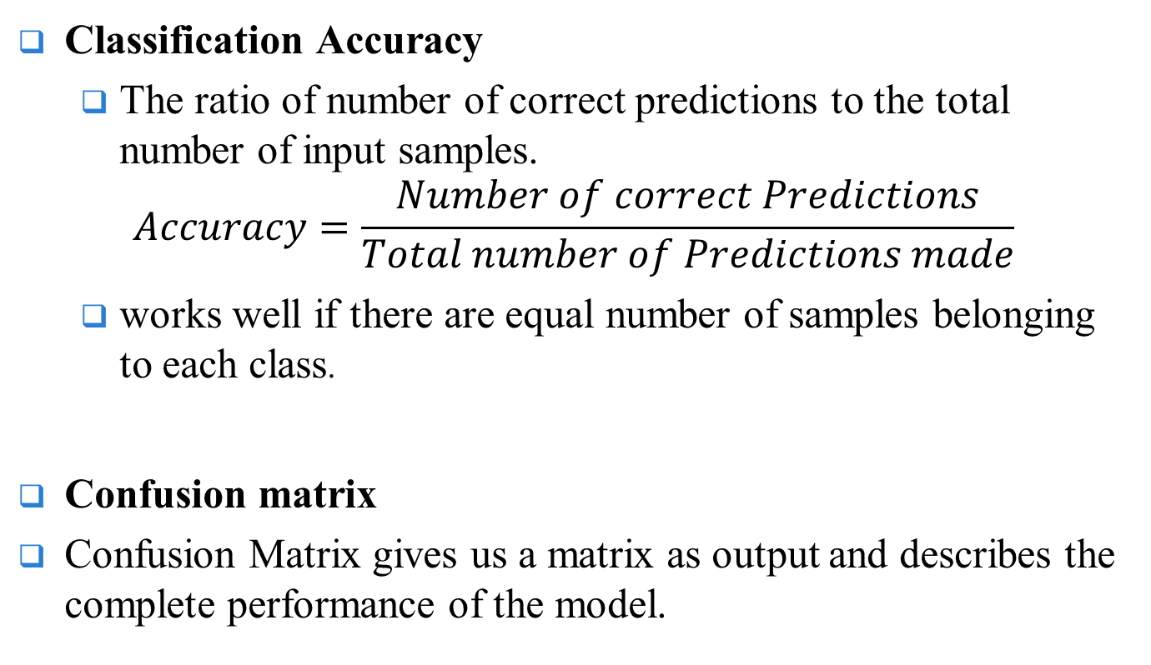
Contd..
Classification Accuracy
The ratio of number of correct predictions to the total number of input samples.
$$Accuracy=\frac{Number of correct Predictions}{Total number of Predictions made}$$
works well if there are equal number of samples belonging to each class.
Confusion matrix
Confusion Matrix gives us a matrix as output and describes the complete performance of the model.
Notes:
https://towardsdatascience.com/metrics-to-evaluate-your-machine-learning-algorithm-f10ba6e38234

Slide 11
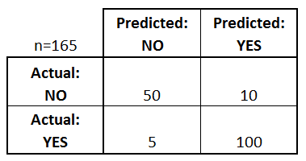
Confusion Matrix
Lets assume we have a binary classification problem. We have some samples belonging to two classes : YES or NO. Also, we have our own classifier which predicts a class for a given input sample.
On testing our model on 165 samples ,we get the following result:
Yes-> Patient
No-> No Disease
Total Predictions= 165
Yes=110 times
No= 55 times
Actual:
Yes =105 times
No = 60 times

Slide 12
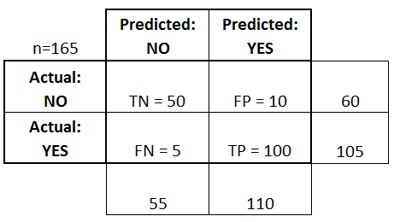
Contd..
There are 4 important terms :
True Positives : The cases in which we predicted YES and the actual output was also YES.
True Negatives : The cases in which we predicted NO and the actual output was NO.
False Positives : The cases in which we predicted YES and the actual output was NO.
False Negatives : The cases in which we predicted NO and the actual output was YES.

Slide 13
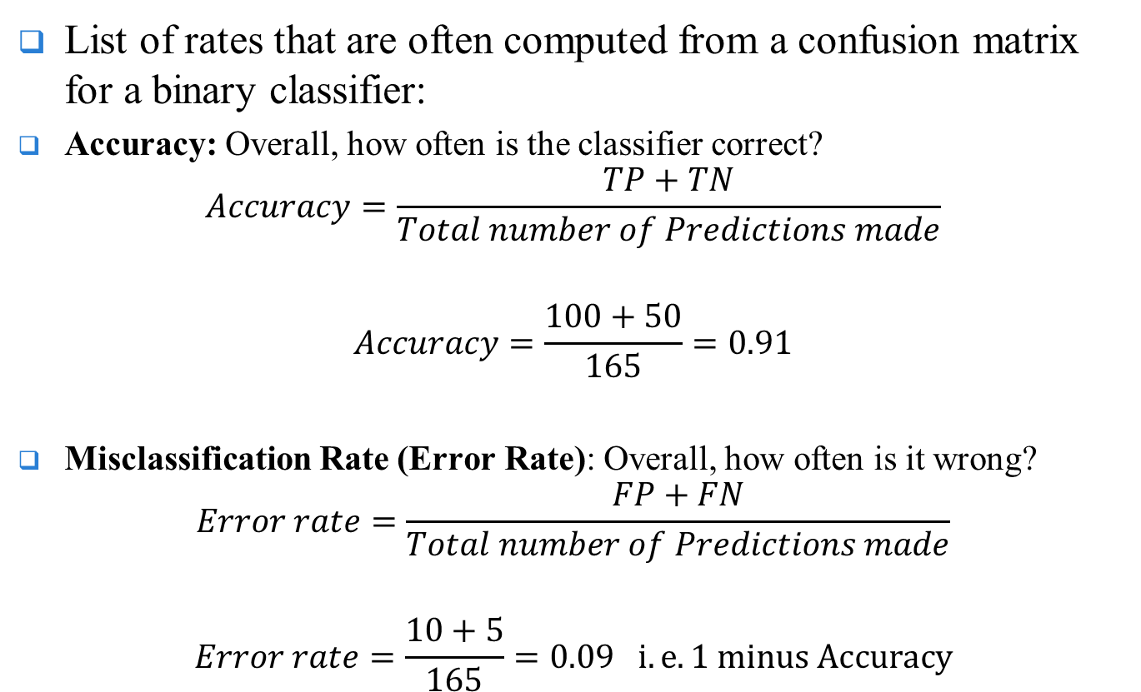
Computations from confusion matrix
List of rates that are often computed from a confusion matrix for a binary classifier:
Accuracy: Overall, how often is the classifier correct?
$$Accuracy=\frac{TP+TN}{Total number of Predictions made}$$
$$Accuracy=\frac{100+50}{165}=0.91$$
Misclassification Rate (Error Rate): Overall, how often is it wrong?
$$Error rate=\frac{FP+FN}{Total number of Predictions made}$$
$$Error rate=\frac{10+5}{165}=0.09 i.e.1 minus Accuracy$$

Slide 14
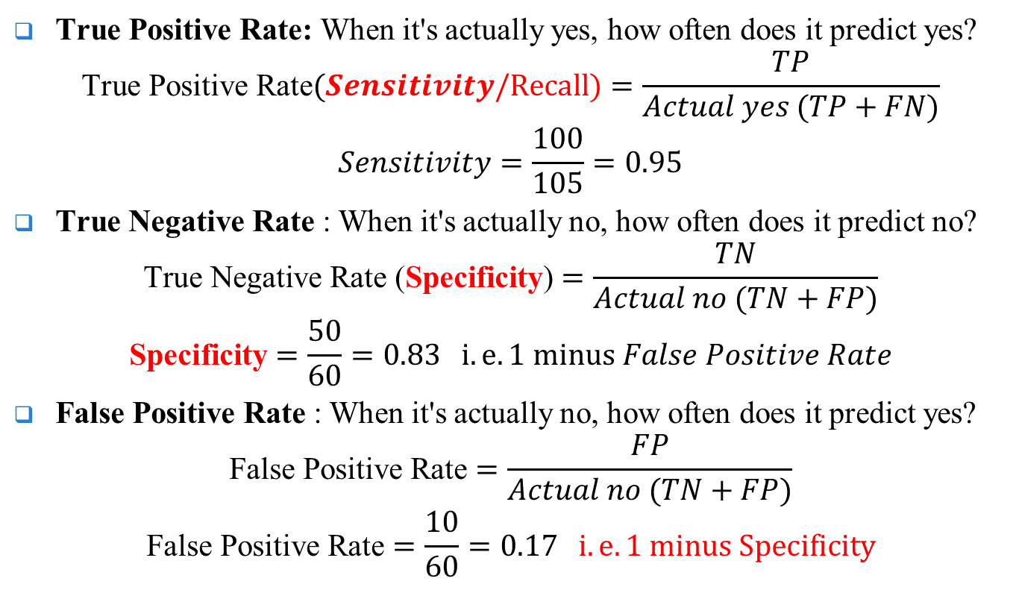
Contd..
True Positive Rate: When it's actually yes, how often does it predict yes?
$$\text{True} \text{Positive} \text{Rate}(Sensitivity/Recall)=\frac{TP}{Actual yes (TP+FN)}$$
$$Sensitivity=\frac{100}{105}=0.95$$
True Negative Rate : When it's actually no, how often does it predict no?
$$\text{True} \text{Negative} \text{Rate}\text{ (}\text{Specificity}\text{)}=\frac{TN}{Actual no (TN+FP)}$$
$$\text{Specificity}=\frac{50}{60}=0.83 i.e.1 minus False Positive Rate$$
False Positive Rate : When it's actually no, how often does it predict yes?
$$\text{False} \text{Positive} \text{Rate}=\frac{FP}{Actual no (TN+FP)}$$
$$\text{False} \text{Positive} \text{Rate}=\frac{10}{60}=0.17 i.e.1 minus Specificity$$

Slide 15
AUC- ROC Curve
A commonly used graph that summarizes the performance of a classifier over all possible thresholds.
It is generated by plotting the True Positive Rate (y-axis) against the False Positive Rate (x-axis)
ROC is a probability curve and AUC represents the degree or measure of separability (simply the area under the curve).
It tells how much the model is capable of distinguishing between classes.
Higher the AUC, the better the model is at predicting 0 classes as 0 and 1 classes as 1.

Slide 16
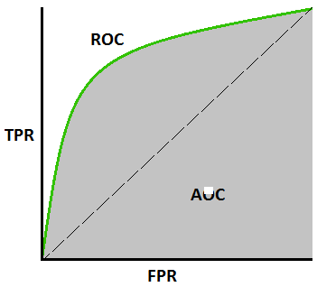
Contd..
.
(Sensitivity)
(1-Specificity)

Slide 17
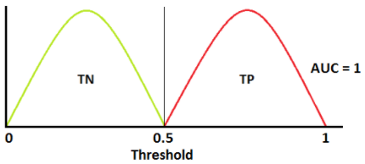
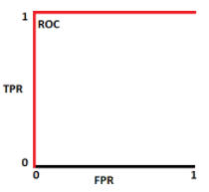
AUC- ROC Curve representation(1)
An ideal situation: Two curves don’t overlap at all
Model has an ideal measure of separability (AUC=1).
It is perfectly able to distinguish between positive class and negative class.
Green-> Negative class
(No disease)
Red-> positive class
(patients with disease)

Slide 18
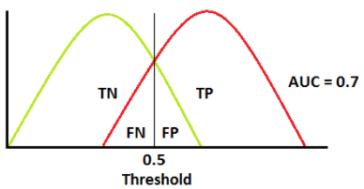
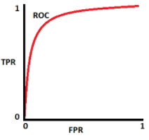
AUC- ROC Curve representation(2)
Two distributions overlap
AUC is 0.7, it means there is a 70% chance that the model will be able to distinguish between positive class and negative class.

Slide 19
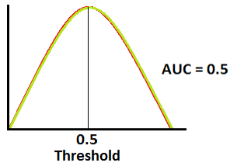
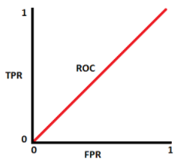
AUC- ROC Curve representation(3)
AUC is approximately 0.5, the model has no discrimination capacity to distinguish between positive class and negative class.

Slide 20
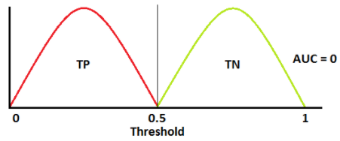
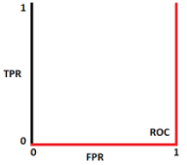
AUC- ROC Curve representation(4)
AUC is approximately 0, the model is actually reciprocating the classes.
It means the model is predicting a negative class as a positive class and vice versa.

Slide 21
Contd..
Note: The ROC curve is normally used to assess the performance of binary classifiers.
ROC curve can be extended to problems with three or more classes using the One vs ALL methodology:
Suppose you have three classes named X, Y, and Z, you will have three ROCs.
one ROC for X classified against Y and Z (X vs Y&Z)
second ROC for Y classified against X and Z, (Y vs X&Z)
third one of Z classified against Y and X. (Z vs X,Y)
With imbalanced datasets, AUC score is calculated from ROC and is a very useful metric in imbalanced datasets.
The AUC score can be calculated with Simpson’s Rule using the graph values

Slide 22
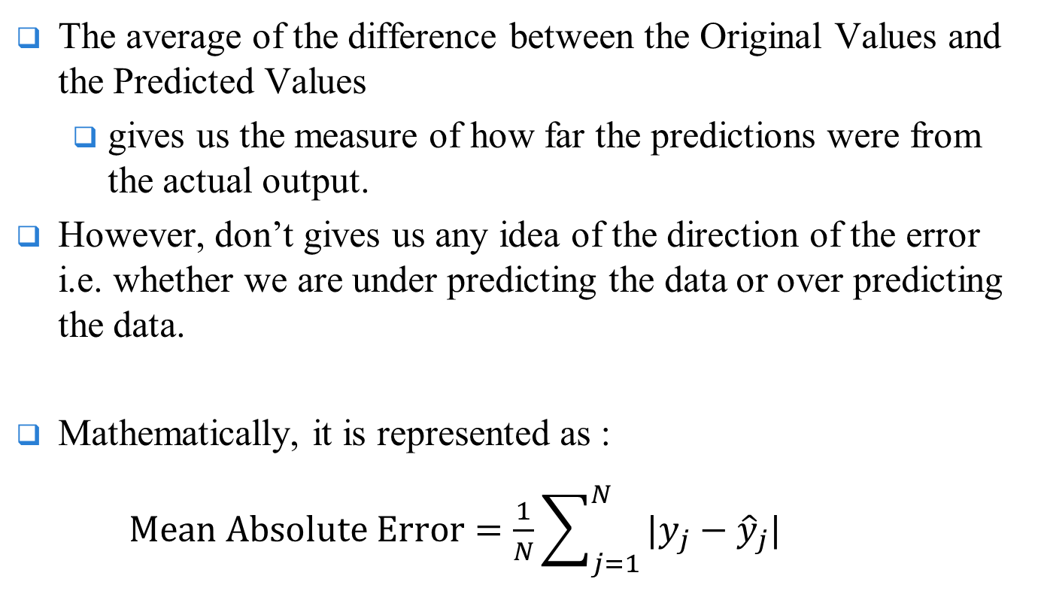
Mean Absolute Error (MAE)
The average of the difference between the Original Values and the Predicted Values
gives us the measure of how far the predictions were from the actual output.
However, don’t gives us any idea of the direction of the error i.e. whether we are under predicting the data or over predicting the data.
Mathematically, it is represented as :
$Mean Absolute Error=\frac{1}{N}\sum_{j=1}^{N}{|y_{j}−{\hat{y}}_{j}|}$

Slide 23
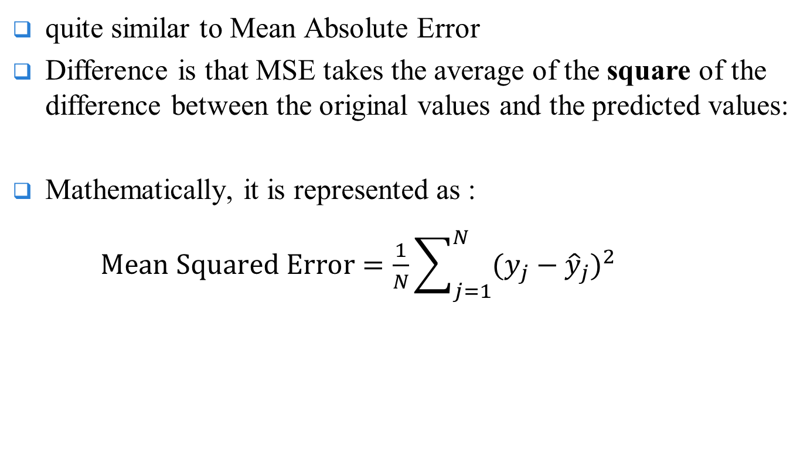
Mean Squared Error (MSE)
quite similar to Mean Absolute Error
Difference is that MSE takes the average of the square of the difference between the original values and the predicted values:
Mathematically, it is represented as :
$Mean Squared Error=\frac{1}{N}\sum_{j=1}^{N}{{(y_{j}−{\hat{y}}_{j})}^{2}}$

Slide 24
ML/PR Challenges
There are a lot of challenges that machine learning professionals face to instil ML skills and create an application from scratch.
Few of them are:
Poor Quality of Data
Feature Extraction
Overfitting and Underfitting of Training Data
Lack of Training Data
Model Selection
Prior Knowledge
Missing Features
Imperfections in the Algorithm When Data Grows
Inadequate Infrastructure
Lack of Skilled Resources

Slide 25
Assignment 3
Analyze the ML challenges mentioned in previous slide and also provide solution to each one that how these challenges can be tackled.

Slide 26
END

